Slide 1
Sexual Assault Prevention and Response Training for Commanders and Leaders
Briefer: MSG Amaka S. Anderson
(703) 571-3496
amaka.s.anderson.mil@army.mil
V2, approved 9 March 2022

Slide 2
Agenda
Retaliation
  What it is
  How to prevent it
Publicize how to report
Encourage reporting
Increased eligibility for Restricted Report
Questions
Notes:
In November 2021, the Secretary of Army directed commanders at all levels receive updated SHARP Training on sexual assault reporting, response and retaliation procedures no later than 30 September 2022. The U.S. Army SHARP Academy was tasked with developing the content and supporting execution as outlined in HQDA EXORD 110-22 SEXUAL ASSAULT PREVENTION AND RESPONSE dated 16 February 2022. The intent is to ensure shared understanding and correct application of updated reporting procedures for sexual assault. Leaders are defined as Squad Leader and above, and includes civilian supervisors. The training will be delivered to leaders by their supporting SHARP professionals.
Phase 1 is complete once all full time SHARP professionals receive training. SHARP Academy will deliver a series of 6, 90 minute instructional sessions via MS Teams MLT 24 March 2022 for SHARP Program Managers, Full time SARCs and VAs across the Army.
Phase 2 begins once all SHARP professionals are trained and will end once all commanders and leaders receive training NLT 24 March 2022.

Slide 3
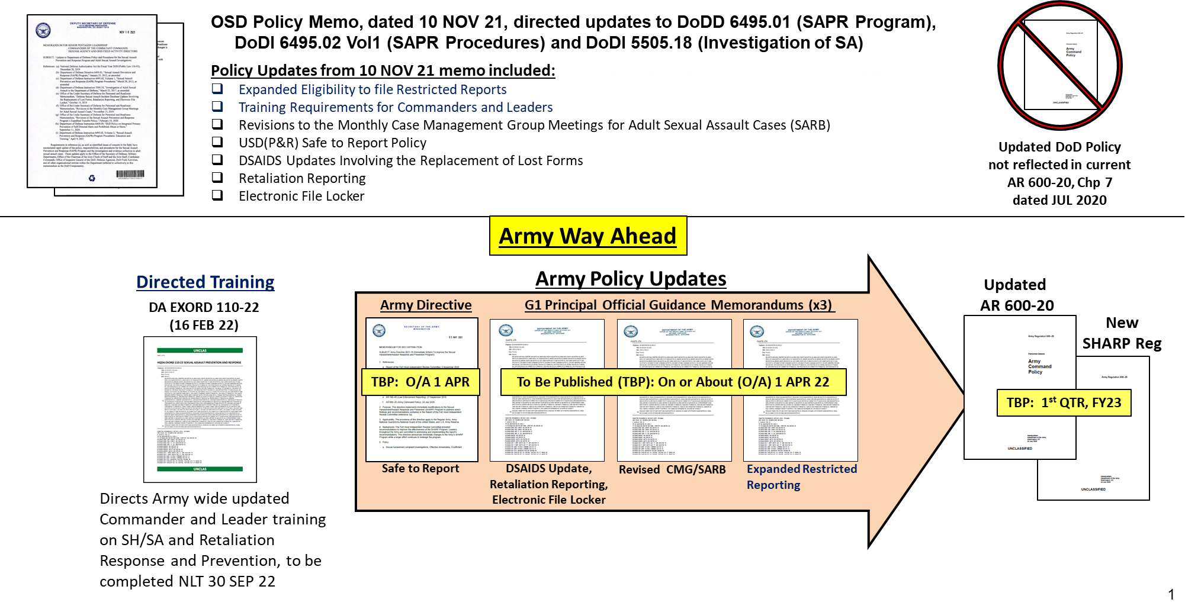
Pending Policy
Notes:
This training has been directed as part of 10 Nov 2021 OSD memorandums. Training requires commanders and leaders to explain to their subordinates what is the appropriate, professional response by the chain of command at every level (officer and enlisted), provide training on incidents of retaliation, reprisal, ostracism, and maltreatment with scenarios to facilitate discussion of appropriate behavior, to include mitigating potential resentment of peers towards victims, bystanders, or witnesses who report a sexual assault. Commanders shall receive training so they also can explain how to prevent retaliation, reprisal, ostracism, and maltreatment in a unit after a report of an alleged sexual assault.
Change to what's written in the EXORD - Training can be executed in small group forums or deskside training.
Leader for this task is defined as SL and Above to include Civilian Supervisors. Commanders have the latitude to expand the requirement for all Leaders, etc.

Slide 4
Retaliation
    Retaliation is defined as:
    (1) Any person subject to the UCMJ who wrongfully takes or threatens to take an adverse personnel action, or wrongfully withholds or threatens to withhold a favorable personnel action with the intent to discourage or retaliate against any person for reporting or planning to report a criminal offense, or making, or planning to make a protected communication*; or
    (2) Acts of cruelty, oppression or maltreatment committed against a victim, an alleged victim or another member of the Army by peers or other persons, because the individual reported a criminal offense or was believed to have reported a criminal offense.
    Retaliatory behaviors include: Reprisal, Ostracism, and Maltreatment
    *This could include victims, bystanders who intervened, or witnesses who report or make a protected communication.
AR 600-20, Army Command Policy
Notes:
See AR 600-20 for further information

Slide 5



Retaliatory Behaviors
Reprisal (CoC Action)
Withholding of favorable actions; or imposing negative personnel actions
For making, preparing to make, or being perceived as making or preparing to make a protected communication.
Can be reported to the SARC, Command, or DoD IG
This type of retaliation should be investigated by the Inspector General.
Ostracism (Peers)
Excluding from social acceptance, privilege, or friendship
For making, preparing to make, or being perceived as making or preparing to make a protected communication.
Can be reported to the SARC, Command, or DoD IG
This type of retaliation should be investigated by the victim’s chain of command.
Cruelty/ Maltreatment
Cruel / oppressive acts (Physical or Psychological)
By superior (Article 93)
or peers (AR 600-20)
Inherently criminal activity (ie, assault, property damage, stalking) will be investigated and addressed by CID.
For making, preparing to make, or being perceived as making or preparing to make a protected communication.
Can be reported to the SARC, Command, or CID
References: AR 600-20, DODI 6495.02, Vol 1Army Command Policy and DoD Directive 7050.06 Military Whistleblower Protection
Notes:
State: Retaliation:
1. It is Illegal, impermissible, or hostile actions.
2. It is perpetrated by the chain of command, peers, or co-workers
3. It is directed towards an individual suspected of making a protected communication like a Sexual Assault/ Harassment or other crime report; being a victim, witness, or intervener; or being a SARC/ VA.
There are three categories of Retaliation:
1. Reprisal: Taking or threatening to take an adverse or unfavorable personnel action, or withholding or threatening to withhold a favorable personnel action
2. Ostracism: Excluding from social acceptance, privilege, or friendship
3. Acts of cruelty, oppression or maltreatment
DoD Directive 7050.06, Military Whistle Blower Protection Act, Section E2.10, protects Soldiers and DoD Civilians from acts of reprisal.
Note: This document is another resource available to the SARC, VA, Commander, and other SHARP personnel.
NOTE: Inherently criminal acts that meet the intent and definition of retaliation (ie, assault, property damage) should be reported to and addressed by CID.
Note: Protected communication (Military Whistleblower Protection Act)
Protected communication is: "A lawful communication to any member of the chain of command, a Member of Congress, an IG or any member of a DoD audit, inspection, or law-enforcement organization, including any office or command official designated to receive MEO complaints from Soldiers in which a military member makes a complaint or discloses information that he or she reasonably believes evidences a violation of law or regulation, gross mismanagement, a gross waste of funds, a gross abuse of authority, or a substantial and specific danger to public health or safety." Reference AR 600-20, Army Command Policy, Glossary, page 210, 24 July 2020
AR 600-20, Chapter 7
The CG, USACIDC will—
(8) Ensure when USACIDC initiates a sexual assault investigation, it also initiates and conducts subsequent investigations related to suspected retaliation against the sexual assault victim, witnesses, and bystanders who intervened, in accordance with DoDI 5505.18, including physical assaults threats and damage to property.

Slide 6
Retaliation Reporting Options Civilians
DA Civilians are eligible to make an Unrestricted Report by signing a DD Form 2910 and have the same retaliation reporting capability as any other victim who has signed a DD Form 2910.
Retaliation pursuant to a report of sexual harassment through EEO will be addressed by EEO/Labor Management and Employee Relations (LMER).
Whistleblower actions will be reported to DoDIG/Installation IG.
Commanders will seek guidance from SJA/EEO regarding retaliation for Civilians.
Notes:
Inherently criminal behavior will be investigated by CID.
Can sign a DD Form 2910-2 and have the retaliation discussed at the SARB.
Can report reprisal to the IG.

Slide 7
Reprisal
What is an adverse Personnel Action (PA) that could be taken or threatened to be taken towards a complainant?
  Counseling that is punitive, supports separation, or adverse evaluation (addressed as a threat to take an action)
  Letter of reprimand (in the official file), caution, or censure
  Adverse evaluation report (unfavorable effect on a Soldier’s career)
  Removal from position, promotion, school, or command list
  Bar to continued service
  Referral for mental health evaluation
2. What is a favorable PA that could be withheld or threatened to be withheld towards a complainant?
  Evaluation
  Promotion recommendation
  Award
  Training
  Attendance at a school
  Assignment
  This is not a comprehensive list!!
DoD Directive 7050.06, Military Whistleblower Protection
Notes:
This is a personal action. Above list is not all inclusive.

Slide 8

Ostracism / Maltreatment
Examples:
Ostracism: exclusion from social acceptance, activities or interactions with intent to interfere with the due administration of justice
Maltreatment: blaming; insulting or bullying; assault; physical or psychological force or threat; abusive or unjustified treatment that results in physical or mental harm.
AR 600-20, Army Command Policy
Notes:
Ostracism – defined as excluding from social acceptance, privilege or friendship a victim or other member of the Armed Forces because:
(a) The individual reported a criminal offense;
(b) The individual was believed to have reported a criminal offense; and
(c) The ostracism was motivated by the intent to discourage reporting of a criminal offense or otherwise to discourage the due administration of justice; and
Acts of cruelty, oppression, or maltreatment committed against a victim, an alleged victim or another member of the Armed Forces by peers or other persons, because the individual reported a criminal offense or was believed to have reported a criminal offense.

Slide 9
Retaliation Vignette #1
SPC Smith reports that her platoon sergeant sexually assaulted her. The other Soldiers in her company do not believe that the platoon sergeant would ever do something like this. The Soldiers begin to discuss rumors they have heard about the facts of the case – that SPC Smith was drunk at the unit party and performed oral sex on another Soldier in full view of everyone there.
SPC Smith’s roommate tells other Soldiers that SPC Smith has a different man in her bed every weekend and enjoys rough sex. Soldiers post comments on the unit Facebook page expressing their support for the platoon sergeant. SPC Smith receives several anonymous messages that she should drop her report if she wants the rumors to stop on social media
SPC Smith reports to the commander that Soldiers are discussing rumors about her case and are posting favorable comments for the platoon sergeant on Facebook. She feels she is being retaliated against because she reported a sexual assault.
Are there any retaliatory behaviors?
What are they?
Best Course of Action: Chain of command takes action on this report. This type of retaliation could be ostracism and should be investigated by the victim’s chain of command. Additional Resources: SJA for assistance.
Notes:
Vignette taken from LTG Darpino’s slide deck from 2015 SAAPM Conference
Commands can change the briefing template and the ranks & names of people in the vignettes. DO NOT change the briefing content or the vignette story lines.

Slide 10
Retaliation Vignette # 2
SPC Smith reports that her platoon sergeant sexually assaulted her. The team leader pulls SPC Smith from her daily duties and assigns her to multiple details. SPC Smith complains to the team leader that she likes her job and has always been told she was doing well. The team leader explains that “as she recovers from her trauma and because she has so many appointments with her lawyers and behavioral health, he wants to take some of the pressure off of her.”
SPC Smith reports to the SARC that her team leader has removed her from her daily duties and assigned her to multiple details. SPC Smith tells the SARC that she likes her job and has always been told she was doing well.
Do you see any retaliatory behaviors?
What are they?
Best Course of Action: Command refers SPC Smith to the local IG. This type of retaliation could be reprisal and should be investigated by the Inspector General. Additional Courses of Action: DoD IG and SJA for assistance.
Notes:
Vignette taken from LTG Darpino’s slide deck from 2015 SAAPM Conference
If the victim does not sign a DD Form 2910-2, the retaliation will not be discussed at the SARB
Commands can change the briefing template and the ranks & names of people in the vignettes. DO NOT change the briefing content or the vignette story lines.

Slide 11
Retaliation Vignette #3
SPC Smith reports that her platoon sergeant sexually assaulted her. Shortly after she made the report she was assigned as the Staff Duty runner after having pulled that duty only two weeks prior. As time goes on she notices that she is on the Staff Duty roster every weekend.
SPC Smith approaches the Operations SGT about this, who states that “everyone has to do their duty” and refuses to discuss it further.
SPC Smith reports to VA that she is pulling Staff Duty every weekend when normally they are only assigned staff duty every 3 or 4 weeks. She feels she is being retaliated against for reporting a sexual assault.
Are there any retaliatory behaviors?
What are they?
Best Course of Action: Chain of command takes action on this report. This type of retaliation could be maltreatment and should be investigated by the victim’s chain of command. Additional Resources: SJA for assistance.
Notes:
Commands can change the briefing template and the ranks & names of people in the vignettes. DO NOT change the briefing content or the vignette story lines.

Slide 12
Leadership Actions
Leader Responsibilities Regarding Retaliation
Leaders must take immediate action when made aware of possible retaliation.
Be clear and up front that retaliation will not be tolerated
Have honest discussions with subordinates about how gossip, rumors and “picking sides” undermines reporting, prevention, response and ultimately, the readiness of the unit
Establish and enforce procedures to protect witnesses and bystanders who intervene to prevent or report sexual assault or sexual harassment, from retaliation, reprisal, ostracism, intimidation, or maltreatment. IAW AR 600-20
  Immediately notify CID whenever the victim of a sexual assault, witnesses, or bystander who intervenes is threatened, assaulted, or suffers property damage. IAW AR 600-20
  The importance of the role of ALL supervisors in protecting victims: That ALL supervisors in the victim’s chain of command, officer and enlisted, are required when they become aware of retaliation, reprisal, ostracism, or maltreatment, to take appropriate measures to protect the victim from retaliation, reprisal, coercion, ostracism, and maltreatment in Unrestricted Reports. (DoDI 6495.02, change 4, 11 Sept 2020)
9
Notes:
Army Policy on Retaliation
• No soldier may retaliate against a victim, an alleged victim or another member of the Armed Forces based on that individual’s report of a criminal offense.
• All reports of retaliatory behavior must be investigated, including actions against other individuals (for example, family members) intended to harm or influence a Soldier.
• Retaliation will be investigated by the DoD Inspector General (IG).
• IAW AR 600-20, retaliation against a victim, witness, intervener, SARCs, VAs, or first responders should be referred to a battalion or higher commander to develop a plan to immediately address the issue and forward the plan to the Sexual Assault Review Board (SARB) chair.
• IAW DODI 6495.02, service members may request a review from a general or flag officer if they experience retaliation, reprisal, restriction, ostracism, or maltreatment involving an administrative separation within one year of the final disposition of their sexual assault case.
• IAW 6495.02, sexual assault victims have the right to communicate with a general or flag officer if they believe there were impacts to their military career because they reported a sexual assault.

Slide 13
Leader Responsibilities Regarding Retaliation cont.
Establish and enforce procedures to protect SARCs, SHARP VAs, and VRs from retaliation, reprisal, ostracism, intimidation, or maltreatment related to the execution of their duties and responsibilities. Unit commanders and/or supervisors will not interfere with or otherwise attempt to negatively influence SHARP professionals in the performance of their duties.
Establish procedures to require commanders to protect witnesses and bystanders who intervene to prevent sexual assaults or who report sexual assaults, from retaliation, reprisal, ostracism, or maltreatment.
Acts of retaliation may require that an HRRT be stood up.
AR 600-20, Chapter 7-11 requires commanders take actions that prevent retaliation
Notes:
A significant portion of a commander’s required response to an unrestricted report of sexual assault (AR 600-20, Chapter 7-11) are efforts to prevent retaliation.
m. (2) Determine if the victim desires or needs a “no contact” order or an MPO to be issued, particularly if the victim and the subject are assigned to the same command, unit, duty location, or living quarters. Coordination with other commanders may be necessary if the subject is assigned to a different commander. MPOs are an effective tool for commanders to maintain the safety of victims and witnesses. Copies of the DD Form 2873 (Military Protective Order (MPO)) will be provided to the victim, subject, and to the military police for entry into federal databases.
Ensure that when an MPO has been issued that the protected victim is informed, in a timely manner, of their option to request transfer from the command to which he or she is assigned (see app I for expedited transfer procedures). In addition, the person seeking the MPO will be advised that the MPO is not enforceable by civilian authorities off post. Victims desiring protection off base should be advised to seek a CPO.
Ensure that appropriate civilian authorities are notified of the issuance of a protective order and the individuals involved in that order in the event an MPO has been issued against a member of the Armed Forces and any individual involved in the order does not reside on a military installation at any time during the duration of the MPO.
(3) Determine the need for temporary reassignment to another unit, duty location, or living quarters on the installation of the victim or the subject being investigated, working with the subject’s commander if different than the victim’s commander, until there is a final legal disposition of the sexual assault report, and/or the victim is no longer in danger.
n. (5) Avoid automatic suspension or revocation of a security clearance and/or Army Suitability Program access, understanding that the victim may be satisfactorily treated for his/her related trauma without compromising his/her security clearance or PRP. Consider the negative impact that suspension of a victim’s security clearance or may have on building a climate of trust and confidence in the Army’s sexual assault reporting system, but make final determination based on established national security standards (see AR 50–5 and DoD 5210.42–R).
(6) Remind personnel that discussion of a sexual assault might compromise an investigation.
(7) Do not allow Soldiers to be retaliated against for reporting sexual assault.
(8) Discourage members from participating in gossip or grapevine speculation about the case or investigation. Instruct unit members to wait until all the facts are known and final disposition of the report has occurred before reaching conclusions.
(11) Continuously monitor the unit’s overall climate to ensure neither the victim nor the subject is being ostracized. Take actions to prevent organizational splintering.
o. (9) With the benefit of the SARC, servicing legal office legal, and/or investigative advice, determine the need for a MPO Copies of the DD Form 2873 will be provided to the victim and subject.
(10) Monitor the well-being of the subject, particularly for any indications of suicidal ideation and homicidal tendencies, and to ensure appropriate intervention occurs if indicated.
(13) Take appropriate action to prevent retaliation against Soldiers who file complaints or report acts of sexual harassment and sexual assault.
(14) Discourage members from participating in gossip or grapevine speculation about the case or investigation. Instruct unit members to wait until all the facts are known and final disposition of the report has occurred before reaching conclusions.
(15) Remind members that discussion of a sexual assault might compromise an ensuing investigation.
(16) Emphasize that the subject is presumed innocent until proven guilty.
(18) Consider some form of unit training; or have an outside expert address the unit regarding preventive measures, as well as some of the emotional or psychological feelings that may manifest themselves, affect the unit, and require the unit’s response during the course of the investigation.
(19) Continuously monitor the unit’s overall climate to ensure neither the victim nor the subject is being ostracized. Take actions to prevent organizational splintering.
AD 2021-16 updates guidance about MPOs
b. Military Protective Orders (MPOs). Effective immediately for all sexual harassment and sexual assault complaints, the first O-6 in the subject’s chain of command will, as soon as possible, but no later than six hours after determining an MPO is warranted (such as the presence of a threat of physical harm), ensure that the subject’s commander issues a DD Form 2873 (Military Protective Order) to the Soldier (subject), submits it to the installation Directorate of Emergency Service or Provost Marshal Office (DES/PMO), and provides a copy to the protected individual (victim).
MPOs are necessary mechanisms to ensure the safety of Soldiers, Family members, and Civilians who report sexual harassment and/or sexual assault. MPOs, implemented through DD Form 2873, constitute a written lawful order issued by a commander that orders a Soldier to avoid contact with those persons identified in the order.
In accordance with reference 1c, MPOs are approved by, “a commanding officer with jurisdiction over the Soldier.” Any commanding officer in the subject’s chain of command has authority to sign MPOs. Commanders will follow all procedures outlined in reference 1e.
Commanders must educate complainants to ensure they understand the ramifications of an MPO. Commanders will ensure, to the maximum extent practicable, that complainants and subjects avoid contact in accordance with the MPO.
Commanders must inform victims that MPOs may not be enforceable by non-military authorities and advise them of their ability to also seek a civilian protective order (CPO) issued by a judge, magistrate, or other authorized civilian official. Commanders should refer victims to Victim Advocates and the installation Office of the Staff Judge Advocate for assistance in obtaining a CPO. Commanders must also inform the subject of the MPO that violation of the MPO is a violation of Articles 90 and/or 92 of the Uniform Code of Military Justice.
Immediately on receipt, the installation DES/PMO will notify the appropriate civilian authorities of the MPO by entering the MPO into the National Crime Information Center (NCIC) Protective Order File. The installation DES/PMO will generate a Law Enforcement Report in the Army Law Enforcement Reporting and Tracking System; MPOs will not be entered into a raw data file. After confirmation that the DES/PMO is not able to enter MPOs in the NCIC system due to State statutes, the PMO/DES will forward the MPO to the United States Army Crime Records Center for entry into NCIC.
AR 600-20, Appendix H describes the procedures that SARCs are required to take when responding to a report of retaliation.
If the person reporting retaliation has not signed a DD Form 2910-2 (Retaliation Reporting Statement for Unrestricted Sexual Assault Cases), the SARC will not discuss the retaliation at the SARB.
Retaliation is also a potential reason to stand up the High Risk Response Team (HRRT). See AR 600-20, Appendix, F-6.
Retaliation is also a reason for an Expedited Transfer of the Victim (AR 600-20, AR 614-100, AR 614-200).

Slide 14
Prevent Retaliation and Encourage Reporting
Engaged Leadership
Leader Led SHARP training
Build Trust between Soldiers and Leaders
Actions speak louder then words
Taking leadership actions with empathy
Build a culture of connectedness
ADP 6-22 C1, Army Leadership and the Profession
11
Notes:
We know that as leaders you understand that there is a lot required of you. Leadership requires that you model the behavior you expect your subordinates to emulate. It will require the highlighted attributes and competencies set a climate where retaliation is not accepted. We also know that this is most easily done in an environment where soldiers and civilians feel connected and part of the team.

Slide 15
Resentment vs Cohesion Vignette #4
PFC Johnson reported that he was sexually assaulted by a fellow platoon member, SPC James. During the investigation many platoon members were interviewed by CID and now rumors are running rampant throughout the platoon. There are very clear lines being drawn that has resulted in two camps within the platoon. One camp supports PFC Johnson and the other defends SPC James. It is starting to effect productivity, readiness, and has derailed unit cohesion.
What actions can you take as a leader to mitigate this situation?
What could you do as a leader to ensure this does not happen in the future?
Notes:
Commands can change the briefing template and the ranks & names of people in the vignettes. DO NOT change the briefing content or the vignette story lines.

Slide 16
Publicizing Options
Senior Commanders must publicize, by all means available, how to report a sexual assault, and how to seek assistance for a sexual assault, including associated reports of retaliation at their locations. This includes publicizing the availability of resources outside of the victim’s immediate chain of command.
  DoD Safe helpline
  SARCs and VAs inside or outside of their respective chains of command
HQDA EXORD, 110-22 Sexual Assault Prevention and Response
Notes:
This is by no means an exhaustive list. Always look for new and creative ways to get the word out.

Slide 17
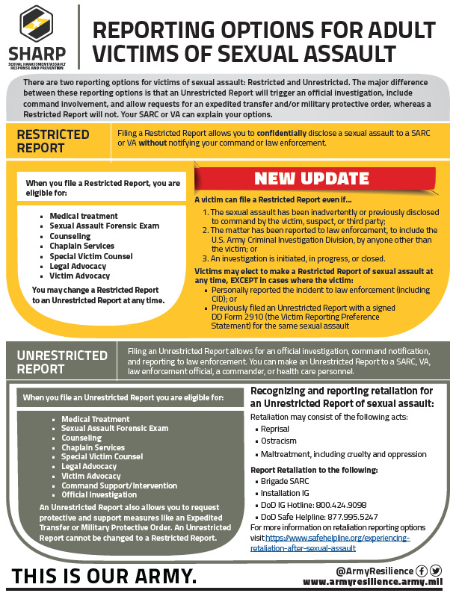
Publicizing Flyers
Notes:
ARD has provided these to assist in getting the information out there.

Slide 18
Increased Eligibility for Restricted Reporting
Victims are now eligible to complete a DD Form 2910 electing a Restricted Report of sexual assault in all cases EXCEPT:
    Where the victim directly reported the sexual assault to Law Enforcement.
    Or when the victim previously filed an Unrestricted Report with a signed DD Form 2910 for the same sexual assault.
    This change refers to a victim's eligibility to file a DD Form 2910, electing a restricted report.
Commanders statutory obligation to report a sexual assault that they are made aware of has not changed!!! They MUST still inform CID/Law Enforcement, SARC, and SJA once made aware.
DODI 6495.02, Vol 1, Sexual Assault Prevention and Response: Program Procedures
Notes:
This means that a victim still has a restricted reporting option even if the sexual assault has been inadvertently or previously disclosed to command by the victim, suspect, or third party; the matter has been reported to law enforcement, to include CID, by anyone other than the victim; or an investigation is initiated, in progress, or closed.

Slide 19
Restricted Reporting Cont.
If the Soldier files a Restricted Report, Commanders will:
    Not ask the SARC or SHARP VA any details about the Restricted Report.
    Not seek to speak to the victim about the reported sexual assault.
Victim may elect to decline participation in the investigation (540K Declination Letter) and should seek the advice of a Special Victims Counsel (SVC).
If the victim fills out a DD Form 2910 electing a restricted reporting option, any services requested or provided will remain confidential and not be disclosed to law enforcement or command.
DODI 6495.02, Vol 1, Sexual Assault Prevention and Response: Program Procedures
Notes:
If the victim fills out a DD Form 2910 electing a restricted reporting option, additional information provided by the victim, or obtained from the victim (including the Sexual Assault Forensic Examination (SAFE), the SARC, SAPR VA or Healthcare) after the DD Form 2910 has been completed shall remain confidential and not be disclosed to Military Law Enforcement (to include CID) or command. CID completes the 540K declination form with the v
Note: If the victim chooses a restricted report after disclosing to command, the case is entered into DSAID twice. Once as a restricted report and once as an “Open with Limited” for the independent investigation. If the victim later decides to change to an unrestricted report on the DD Form 2910, then the two DSAID entries will be merged.

Slide 20
Reporting Options for Civilians
Civilians are eligible to file Unrestricted Reports with a DD Form 2910 and receive SHARP Services.
  Services of a SARC and VA:
    Crisis Intervention
    Safety Assessment
    Safety Planning
    Accompaniment to Appointments and Interviews
    Case Management
Civilians can also report sexual harassment directly to the Commander IAW 10 USC 1561.
Sexual Harassment will be addressed by EEO/Labor Management and Employee Relations (LMER).
Notes:
Case Management includes the SARB.
DD Form 2910-2

Slide 21
Commanders actions
When a Commander is made aware of a sexual assault they must:
  Notify CID
  Notify SARC and VA
  Notify Legal
  Notify victim that they still have the option to file a Restricted Report
  Submit a Sexual Assault Incident Response Oversight (SAIRO) report (BN commander)
  As a reminder, at every CMG meeting, the CMG Chair will ask the CMG members if the victim, victim’s family members, witnesses, bystanders (who intervened), SARCs and SAPR VAs, responders, or other parties to the incident have experienced any incidents of retaliation, reprisal, ostracism, or maltreatment. (DoDI 6495.02, change 4, 11 Sept 2020)
AR 600-20, Army Command Policy
Notes:
When in doubt, call your SARC!!!! DO NOT INVESTIGATE !!!!
Is the victim does not make an Unrestricted Report, commanders will:
(a) Not ask the SARC or VA about the Restricted Report.
(b) Not seek to speak to the victim about the sexual assault.

Slide 22
QUESTIONS?

Slide 23
References
Use slide deck provided to train all leaders (squad leader and above, including civilian supervisors) NLT 30 September 2022
References:
  DODI 6495.02, Vol 1, Sexual Assault Prevention and Response: Program Procedures dated 10 November 2021
  AR 600-20, Army Command Policy dated 24 July 2020
  ADP 6-22, C1, Army Leadership and the Profession dated 25 November 2019
  HQDA EXORD, 110-22 Sexual Assault Prevention and Response dated 16 February 2022

